Slide 1
Phoenix Technologies Data Scientist Salary Analysis
Prepared for the CEO
Joshua Soiro – April 2025

Slide 2
Global Data Science Talent Market
Demand for data science professionals has surged post-COVID and recession.
Tech, healthcare, and finance industries lead the hiring boom.
Global salaries reflect this demand, with sharp increases in recent years.
Remote work and digital transformation broaden the hiring pool.

Slide 3
Salary Comparison: Global vs US
Global median salary: $88,000 USD
US median salary: $150,000 USD – ~70% higher
U.S.-based companies face steep competition for talent from Big Tech.
Offshore hiring can be more cost-effective, but role-specific.

Slide 4
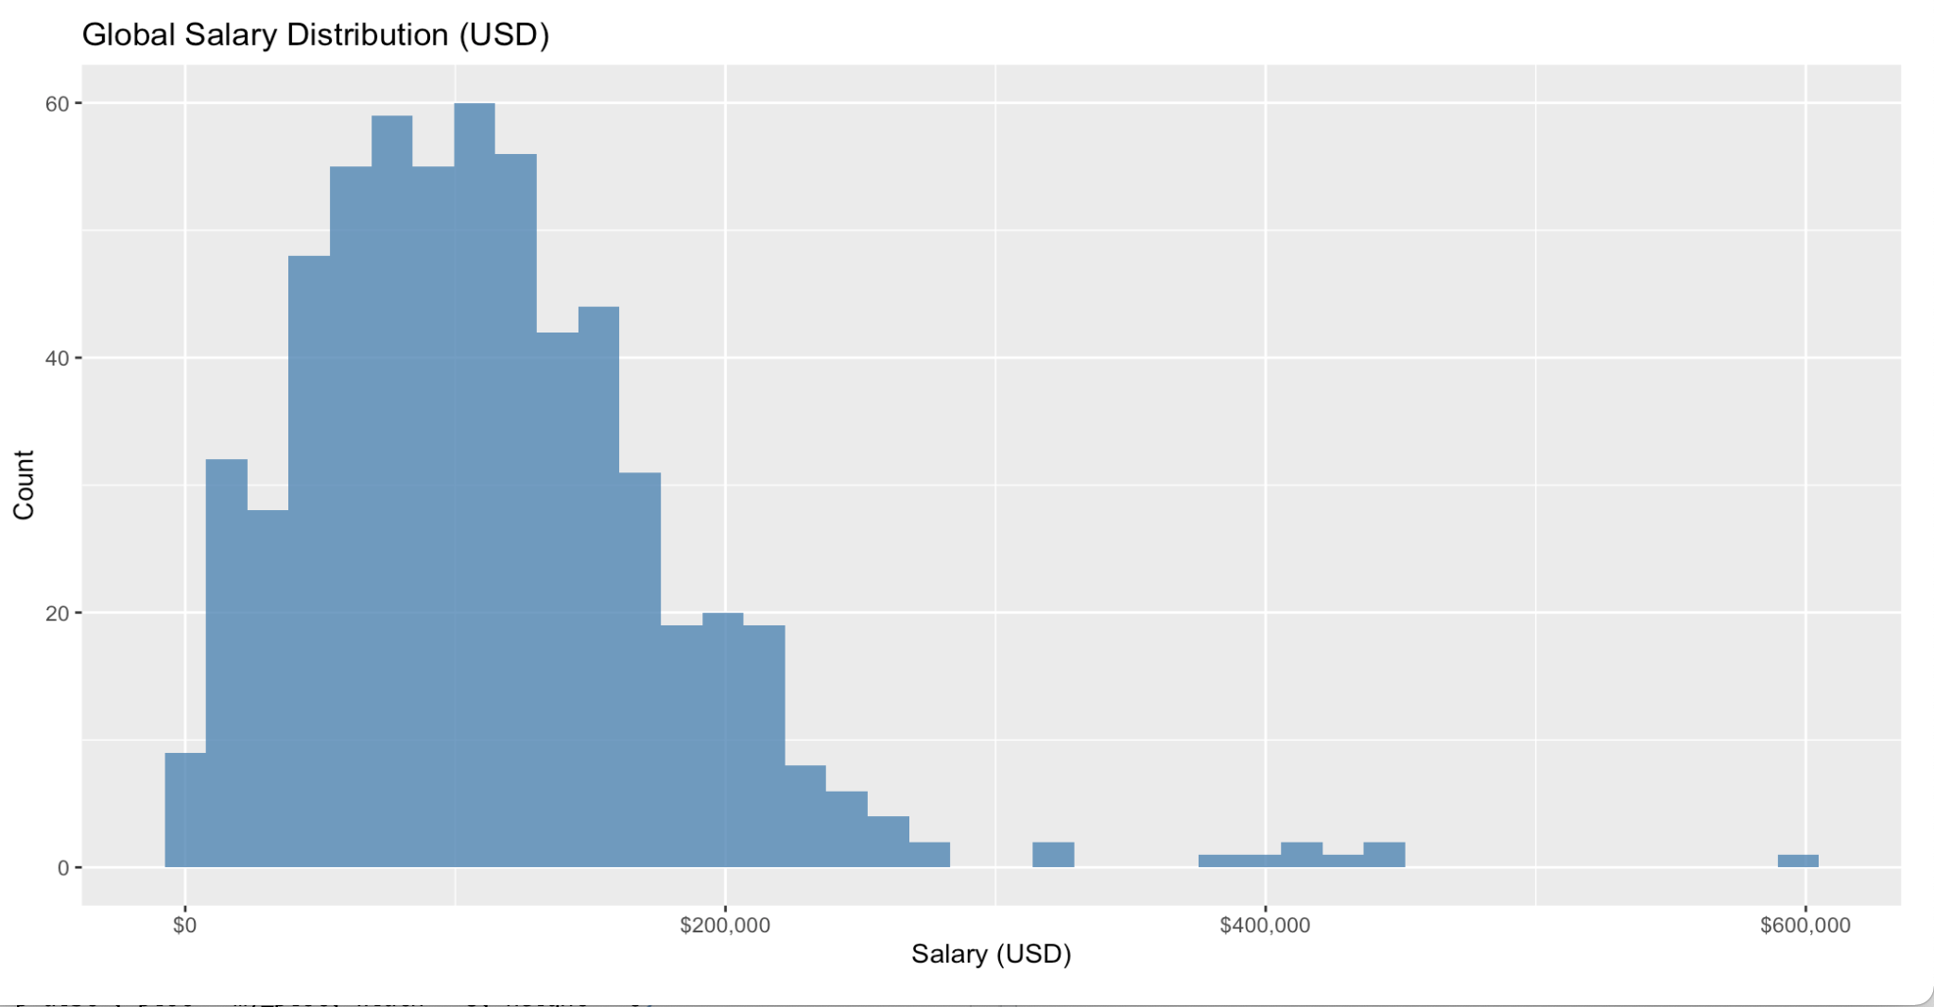

Slide 5
Pay by Experience Level
Entry-Level (EN): $55k Global | $95k U.S. – recommended for junior analysts
Mid-Level (MI): $80k Global | $120k U.S. – suitable for operational projects
Senior-Level (SE): $120k Global | $170k U.S. – ideal for key leadership roles
Executive-Level (EX): $175k–250k+ – critical for strategic vision and team-building

Slide 6
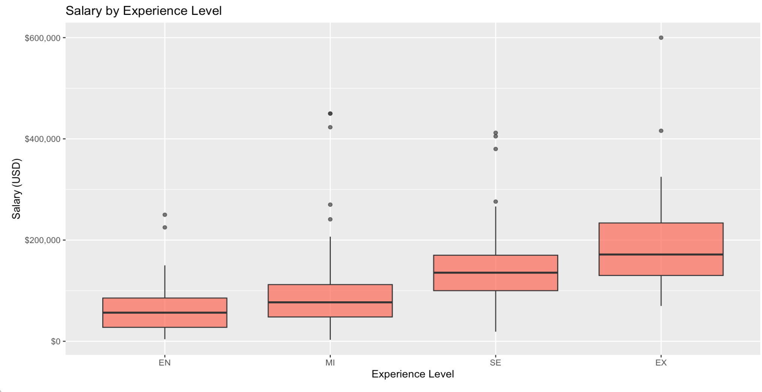

Slide 7
Company Size Impacts on Compensation
Small firms (<50): Median ~ $75k – opportunity for equity-based incentives
Medium firms (50–250): Median ~ $95k – growing reputation & budget
Large firms (>250): Median ~ $120k – high base + benefits
As a small but expanding company, we should adopt a hybrid strategy: competitive salaries + long-term incentives

Slide 8
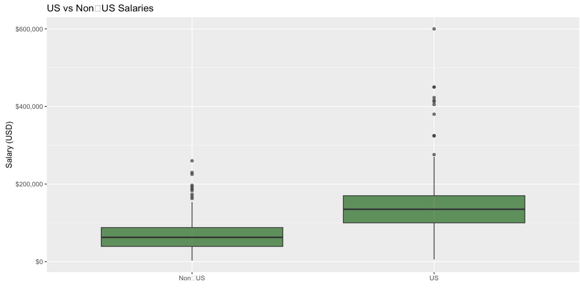
Onshore vs Offshore
Much cheaper to hire someone offshore, but requires stronger skills and more obligation from employee

Slide 9
Remote Work & Salary Trends
Fully remote roles are in high demand and command premium salaries.
Median salaries: On-site ~$80k | Hybrid ~$100k | Remote ~$105k
Remote roles expand talent access but require strong project management.
Recommendation: Flexible work model with compensation matching expectations.

Slide 10
Strategic Hiring Recommendations
U.S. Senior Data Scientist: $150k–$180k + stock/options.
Mid-Level (U.S. or Offshore): $80k–$100k depending on skills & location.
Offshore Entry-Level Support: $55k–$70k, ideal for analytics or dashboard roles.
Start with U.S. Senior Data Scientist able to be in office, and fill other positions gradually.
Offer growth paths and learning budgets to retain talent.

Slide 11
Proposed Hiring Model
1 U.S.-based Senior Data Scientist (Team Lead): $160k base + 10% bonus
1 Offshore Mid-Level Data Analyst: $80k USD
1 Entry-Level Analyst (Remote): $60k USD
Total Annual Cost Estimate: ~$300k for a scalable 3-person team
Potential cost savings vs. all-U.S. team: ~35% annually

Slide 12
Final Recommendation
To lead in data science, we must invest in both leadership and operational talent.
Initially hire Senior-level data scientist offering $130,000-145,000 USD
Able to take ownership of data science strategies and mentor future 3-person team
Best balance of skill, cost, and leadership for company’s growth
Compensation should be aligned with industry standards to attract top-tier candidates.

Slide 13
Thank You – Let’s Build the Future of Phoenix Technologies
For questions or further discussion, contact: Joshua Soiro soirojo@merrimack.edu Prepared for the CEO – April 2025

